Slide 1

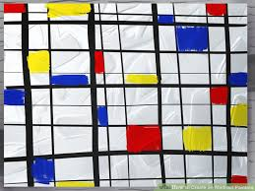
3. Drawing
Let’s Learn
Aj. Andrew Davison, CoE, PSU Hat Yai Campus
E-mail: ad@fivedots.coe.psu.ac.th

Slide 2
Outline
Screen Coordinates
Lines
Rectangles
Circles, ellipses, arcs
Polygons
Text
Images

Slide 3
1. Screen Coordinates
screen = pygame.display.set_mode((640,480))
The window is 640 pixels wide by 480 pixels high
a pixel is a drawing square on the screen surface
Pygame can create many surfaces which can all be drawn on
for now, I'll use only the screen surface

Slide 4
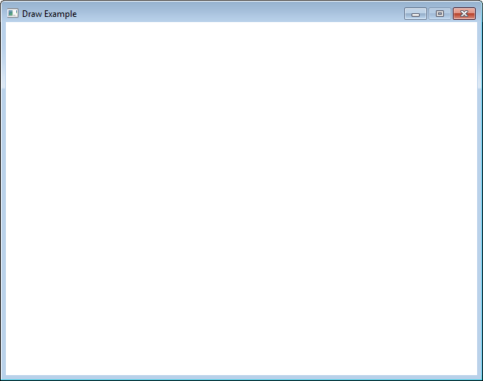
Screen Coordinates
The screen has pixel coordinates starting from (0,0) in the top-left, and moving across and down.
(0,0)
x-axis
y-axis
(320,240)
(x, y)
(639,479)
(640-1,480-1)

Slide 5
Drawing with Python
draw.py contains examples of:
Separate and joined lines; normal and anti-aliased
Rectangles (filled and unfilled)
Circles
Ellipses
Arcs
Polygons
Text (system and custom)
Images

Slide 6
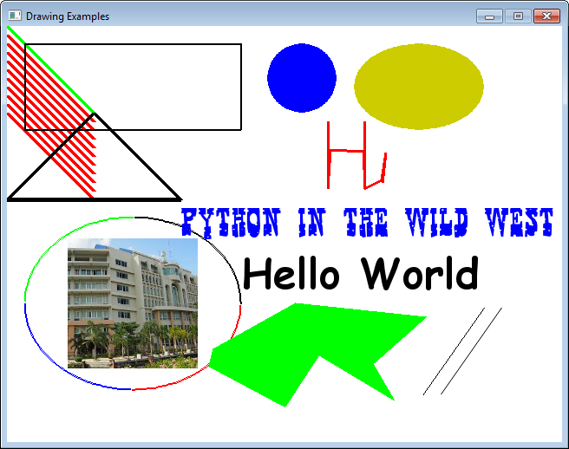
draw.py

Slide 7
Top Level of draw.py
pygame.init()
screen = pygame.display.set_mode((640, 480))
screen.fill(WHITE)
pygame.display.set_caption("Drawing Examples")
drawStuff(screen)
clock = pygame.time.Clock()
running = True
while running: # game loop
clock.tick(30)
for event in pygame.event.get():
if event.type == QUIT:
running = False
pygame.display.update()
pygame.quit()

Slide 8
def drawStuff(screen):
# draw a green line
pygame.draw.line(screen, GREEN, (0, 0), (100, 100), 5)
# draw several red lines
for y in range(0, 100, 10):
pygame.draw.line(screen, RED, (0, 10+y), (100, 110+y), 5)
:
:

Slide 9
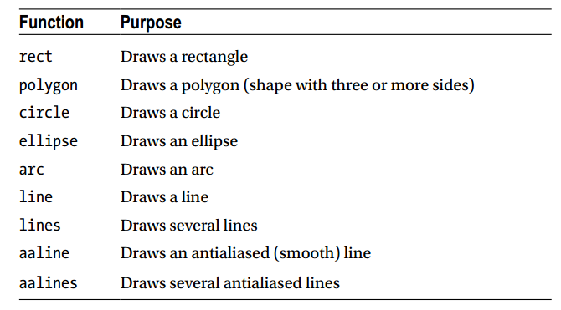
Pygame.draw Module
http://www.pygame.org/docs/ref/draw.html

Slide 10
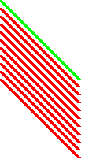
2. Draw Separate Lines
(0,0)
(100,100)
Each line needs a drawing surface (the screen), a color, a start point, an end point, and line thickness.
# draw a green line from (0,0) to (100,100); 5 pixels thick
pygame.draw.line(screen, GREEN, (0, 0), (100, 100), 5)
# draw red lines from (0,10) to (100,110); 5 pixels thick
for y in range(0, 100, 10):
pygame.draw.line(screen, RED, (0, 10+y), (100, 110+y), 5)

Slide 11
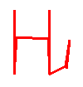
Drawing Joined Lines
(370,110)
(370,187)
Each point is an (x,y) tuple inside a points tuple
# draw thick red connected lines (that looks like "Hi")
points = ( (370, 110), (370, 187),
(372, 143), (411, 144),
(412, 187), (412, 110),
(412, 187), (432, 177),
(436, 146), (433, 180) )
pygame.draw.lines(screen, RED, False, points, 3)

Slide 12
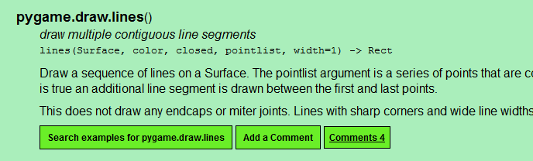
pygame.draw.lines(screen, color, closed, pointlist, thickness)
draws a series of lines, connecting the points specified in pointlist
pointlist is a list of tuples, specifying a series of points, e.g. to draw a ‘V’ you might use [(100,100), (150,200), (200,100)], with closed = False
closed should be either True or False, indicating whether to connect the last point back to the first
thickness is the thickness of the line (in pixels).
http://www.pygame.org/docs/ref/draw.html

Slide 13
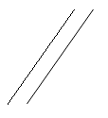
Anti-Aliasing (smoothing)
Second line (using anti-aliasing) seems much smoother.
pygame.draw.line(screen, BLACK, (480, 425), (550, 325), 1)
pygame.draw.aaline(screen, BLACK, (500, 425), (570, 325), 1)
(550,325)
(570,325)
(480,425)
(500,425)

Slide 14
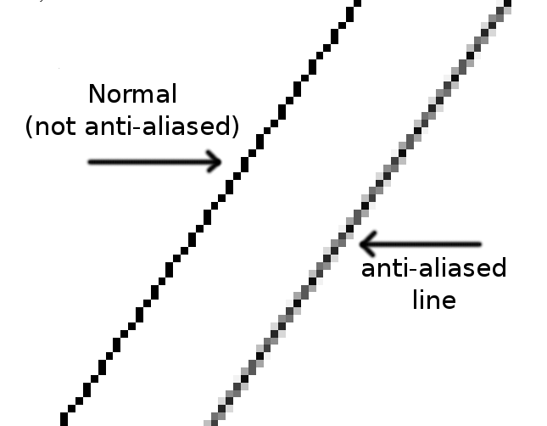
A closer look at Anti-Aliasing
Zoomed in:

Slide 15
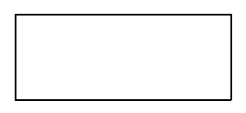
3. Drawing a Rectangle
Each rectangle needs a drawing surface (the screen), a color, a top-left point, width, height, and optional line thickness.
thickness of 0 indicates a filled rectangle
if no thickness given, 0 is used
# draw a unfilled black rectangle;
# top-left (x,y) = (20,20), (width,height) = (250,100)
pygame.draw.rect(screen, BLACK, (20, 20, 250, 100), 2)
(20,20)
250
100

Slide 16
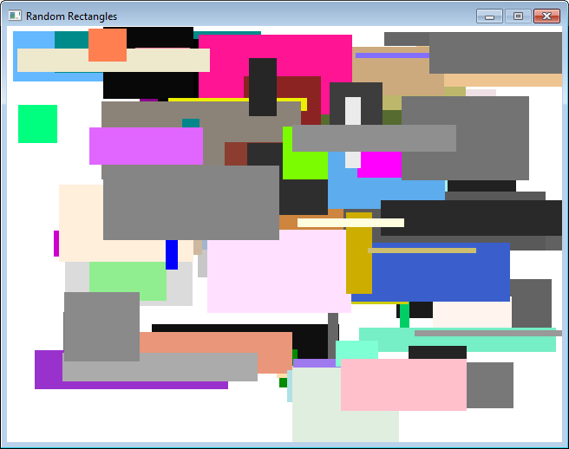
3.1. Draw Random Rectangles
randomRects.py draws 100 rectangles at random positions filled with random colors.

Slide 17
randomRect.py
import pygame, sys, random
from pygame.color import THECOLORS
from pygame.locals import *
pygame.init()
screen = pygame.display.set_mode([640,480])
screen.fill(THECOLORS['white'])
pygame.display.set_caption("Random Rectangles")
for i in range (100):
# pick random numbers for rectangle size and position
width = random.randint(0, 250)
height = random.randint(0, 100)
top = random.randint(0, 400)
left = random.randint(0, 500)
# pick a random color by name
color_name = random.choice( list(THECOLORS.keys()) )
color = THECOLORS[color_name]
# draw the rectangle
pygame.draw.rect(screen, color, (left, top, width, height)) # 0

Slide 18
No change to the game loop.
clock = pygame.time.Clock()
running = True
while running: # game loop
clock.tick(30)
# handle events
for event in pygame.event.get():
if event.type == QUIT:
running = False
# update game state (nothing yet)
# redraw game
pygame.display.update()
pygame.quit()

Slide 19
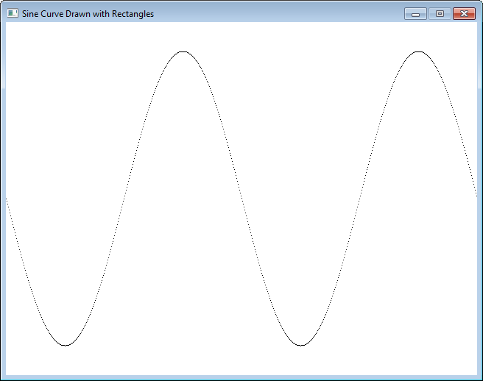
3.2 Draw a Sine Curve
sineRects.py draws a sine curve using small 1x1 rectangles
look closely

Slide 20
sineRects.py
import pygame, sys, math
from pygame.locals import *
BLACK = ( 0, 0, 0)
WHITE = ( 255, 255, 255)
pygame.init()
screen = pygame.display.set_mode([640,480])
screen.fill(WHITE)
pygame.display.set_caption("Sine Curve Drawn with Rectangles")
for x in range(0, 640):
y = int(math.sin(x/640.0 * 4*math.pi) * 200 + 240) # sine curve
# draw using small rectangles
pygame.draw.rect(screen, BLACK, (x, y, 1, 1), 1)
# (x,y) is the loc of each rectangle; (width,height) == 1
clock = pygame.time.Clock()
running = True
while running:
: # game loop unchanged

Slide 21
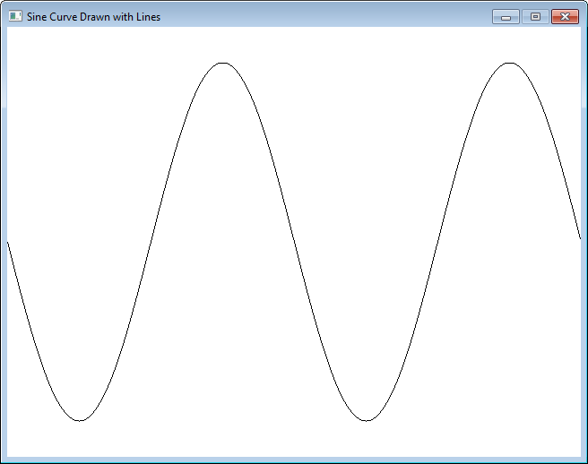
A Smoother Sine Curve
sineLines.py draws a sine curve using connected lines.

Slide 22
sineLines.py
import pygame, sys, math
from pygame.locals import *
BLACK = ( 0, 0, 0)
WHITE = ( 255, 255, 255)
pygame.init()
screen = pygame.display.set_mode([640,480])
screen.fill(WHITE)
pygame.display.set_caption("Sine Curve Drawn with Lines")
coords = []
for x in range(0, 640):
y = int(math.sin(x/640.0 * 4*math.pi) * 200 + 240) # sine curve
coords.append((x, y)) # make a list of points
pygame.draw.lines(screen, BLACK, False, coords, 1)
# plot the points, joined together
clock = pygame.time.Clock()
running = True
while running:
: # game loop unchanged

Slide 23

4. Drawing a Circle
Each circle needs a drawing surface (the screen), a color, a center point, radius, and optional line thickness.
thickness of 0 indicates a filled circle
# draw a filled blue circle at (340,60) radius 40
pygame.draw.circle(screen, BLUE, (340, 60), 40, 0)
(340,60)
40

Slide 24
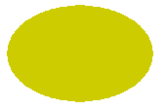
Drawing an Ellipse
(400,20)
150
100
An ellipse is drawn inside a 'bounding box'
Each ellipse needs a drawing surface (the screen), a color, a top-left point, width, height (for the box), and optional line thickness.
thickness of 0 indicates a filled ellipse
If the box is square, the ellipse will be a circle
# draw a mustard-colored ellipse, # inside a rectangle defined as
# top-left (x,y) = (400,20), (width,height) = (150,100)
MUSTARD = (204, 204, 0)
pygame.draw.ellipse(screen, MUSTARD, (400,20,150,100), 0)

Slide 25
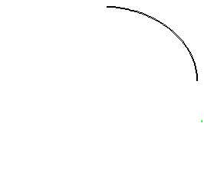
Drawing an Arc
(20,220)
250
π/2 angle
200
0 angle
An arc is a partially drawn ellipse
the ellipse is defined using a bounding box
the arc of the ellipse is defined using a starting and ending point in radians
#draw an arc
pygame.draw.arc(screen, BLACK,(20,220,250,200),0, pi/2, 2)

Slide 26
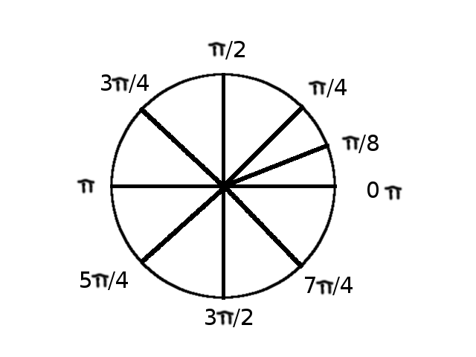
Common Angles in Radians

Slide 27
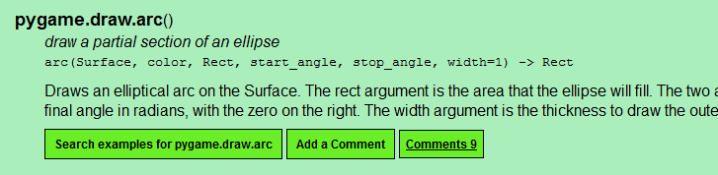
pygame.draw.arc(screen, color, (x,y,width,height), start_angle, stop_angle, thickness)
draws an arc (portion of an ellipse)
(x,y,height,width) are the coordinates of a rectangle that the arc would fit inside if it were drawn all the way around
if height and width are equal, then the rectangle is a square, and the arc will be a portion of a circle
start_angle and stop_angle are the angle on the unit circle in radians (not degrees) where the arc starts and stops
http://www.pygame.org/docs/ref/draw.html

Slide 28
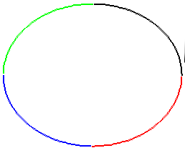
Multiple Arcs
# draw fours arc to form an ellipse;
# an arc has a bounding box, start angle, end angle, line width
pygame.draw.arc(screen, BLACK,(20, 220, 250, 200), 0, pi/2,2)
pygame.draw.arc(screen, GREEN,(20, 220, 250, 200), pi/2, pi,2)
pygame.draw.arc(screen, BLUE, (20, 220, 250, 200), pi, 3*pi/2, 2)
pygame.draw.arc(screen, RED, (20, 220, 250, 200), 3*pi/2, 2*pi,2)
(20,220)
250
200

Slide 29
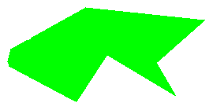
5. Drawing a Polygon
(332,319)
(483,335)
(237,372)
(232,392)
Each point is an (x,y) tuple inside a points tuple
A polygon is always closed
its last point connects back to the first
# draw a green filled polygon
points = ( (237, 372), (332, 319),
(483, 335), (422, 389),
(447, 432), (359, 379),
(320, 439), (232, 392) )
pygame.draw.polygon(screen, GREEN, points, 0)

Slide 30
6. Text
Drawing text takes 3 steps:
set the font: the default font, a system font, or a custom font loaded from a "ttf" file
Convert (render) the text into an image
Draw (blit) the image onto the screen

Slide 31

Using the Default font
# 1. load default font; 48pt size
font = pygame.font.Font(None, 48)
# 2. render anti-aliased (smooth) black text as an image
textImage = font.render("Hello World", True, BLACK)
# 3. draw text image with its top-left corner at (270,250)
screen.blit(textImage, (270, 250))
(270,250)

Slide 32
System Fonts
System fonts are the ones in Windows (or the Mac, or Linux).
you can print a list using
print("All system fonts:", sorted(pygame.font.get_fonts()))
may not be the same on different computers
if a font is not present then the default font is used instead

Slide 33

Using MS Windows "Comic Sans" font
# 1. load font; 48pt size, bold, not italic
font = pygame.font.SysFont('comicsansms', 48, True, False)
# 2. render anti-aliased black text as an image
textImage = font.render("Hello World", True, BLACK)
# 3. draw text image with its top-left corner at (270,250)
screen.blit(textImage, (270, 250))
(270,250)

Slide 34
Using a Custom Font
You can use a TrueType (ttf) font file
many excellent free fonts are available online
e.g. at http://www.1001freefonts.com/
Including a custom font in your game means that you know the right font will be used no matter what computer your game is on.

Slide 35

Using a Mexican font
from http://www.1001freefonts.com/mexican-fonts.php
# 1. load font file; 40pt size
myFont = pygame.font.Font("GringoNights.ttf", 40)
# 2. render anti-aliased blue text as an image
labelImage = myFont.render("Python in the Wild West", True, BLUE)
# 3. draw text image with its top-left corner at (200,210)
screen.blit(labelImage, (200, 210))
(200,210)

Slide 36
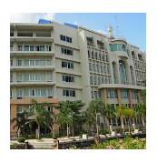
7. Using an Image
(70,245)
Prepare the image (jpg, bmp, gif, or png format)
use JPG for big photos
use PNG for small photos with transparent parts
use GIF for simple line drawings
Put image file in same directory as program.
Use pygame.image.load() and blit():
# load graphics; top-left at (70,245)
image = pygame.image.load("saengthong.jpg").convert()
screen.blit(image, (70,245))

Slide 37
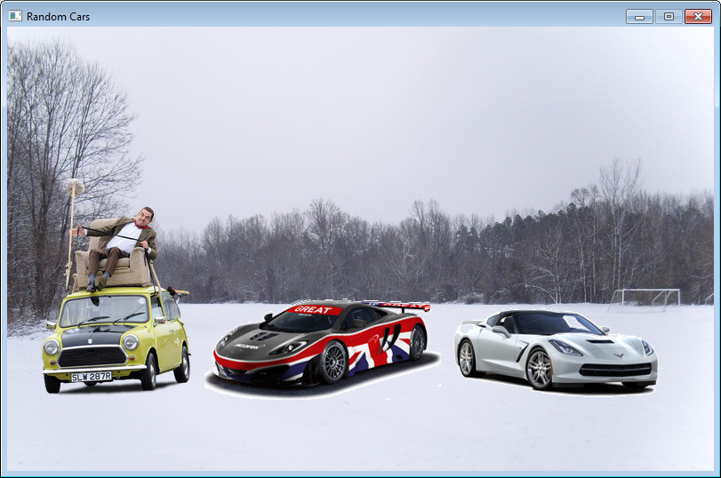
Cars in a Snowy Field
randomCars.py draws three random car images on top of a background image
guess
which is
my car?

Slide 38
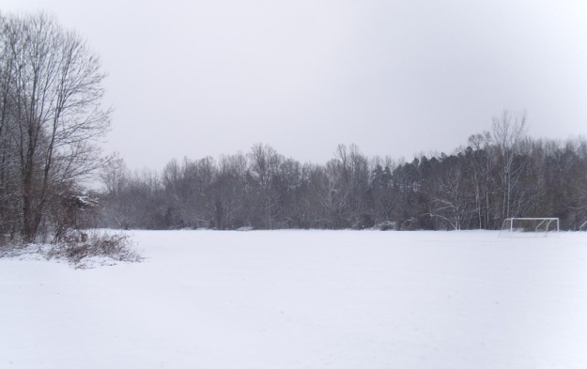
randomCars.py
field.jpg
import pygame, sys, random
from pygame.locals import *
pygame.init()
screen = pygame.display.set_mode([795, 500])
# big enough for background image
pygame.display.set_caption('Random Cars')
# draw background image
background = pygame.image.load("field.jpg").convert()
screen.blit(background, (0,0))
:

Slide 39
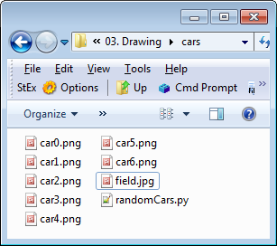
# draw 3 random car images spaced out across the window
x = 30
for i in range (3):
id = random.randint(0, 6) # choose a number between 0-6
car = pygame.image.load("car" + str(id) + ".png").convert_alpha()
# the images are all called car?.png, with ? = 0 to 6;
# they have transparent backgrounds
screen.blit(car, (x,420-car.get_height())) # base of images at y == 420
x += car.get_width() + 10
clock = pygame.time.Clock()
running = True
while running:
: # game loop unchanged

Slide 40
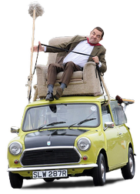
Images with Transparent Parts
The car images are PNG files with transparent backgrounds.
This means they must be converted to Pygame surfaces using convert_alpha():
car = pygame.image.load("car0.png").convert_alpha()
there is nothing
in the background
of the image
car0.png

Slide 41
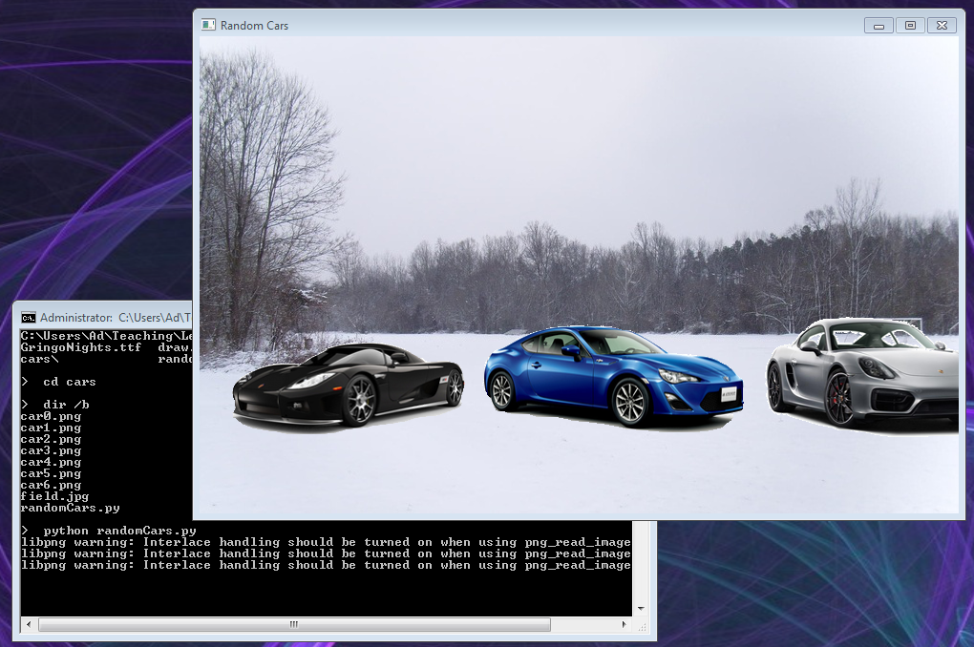
Pygame issues a warning (not an error) when using convert_alpha() on some types of PNG files
it's because Pygame is using an old PNG library
ignore the warning messages

Slide 42
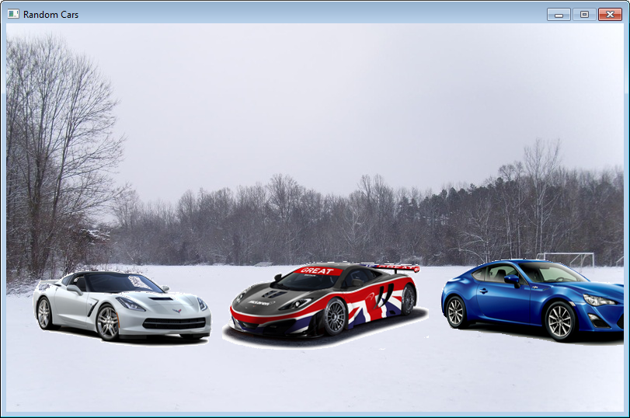
Positioning the Cars
The bottom of the cars line up at y == 420
y == 420

Slide 43
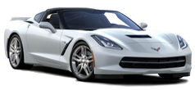
The lining up requires a bit of maths since the position of an image is set by its top-left corner
y = 420 – image's height
screen.blit(car, (x,420-car.get_height()))
(x, y)
width
height
420

Slide 44
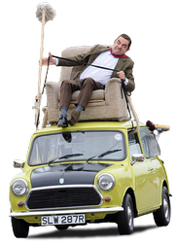
The x value is also a bit tricky since the cars must be spaced out across the background without overlapping.
calculate a new x value by adding the car image's width (plus a bit extra)
x += car.get_width() + 10
(x, y)
(old x,
old y)
width
10
420

